Slide 1

Sprint 4 Review Group: Students INC.

Slide 2
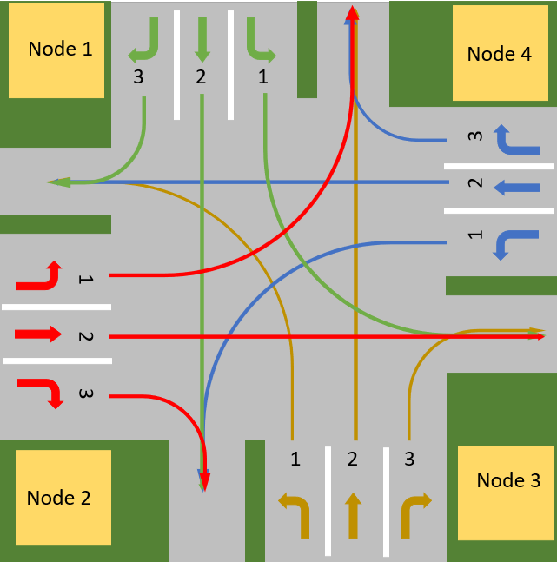
Use Case

Slide 3
A Node Software Overview Diagram
Node Communication
Node Management (Decision-Making)
Lane Management
Traffic Lights Management

Slide 4

Demo

Slide 5

What went well?
What went well?

Slide 6
What can be improved?
What could be improved?

Slide 7

Questions
Questions

